Slide 1
tohfa- a gesture of love
Bhavya solanki E202
Ishwari tilekar E209
Prachi rout E230

Slide 2
contents
1. Home Page
2. Login/Sign-up Page
3. Categories
4. About Us
5. Features & Functionalities
6. Contact Us Page

Slide 3
Problem statement
How can we design a user-friendly and efficient gift shop website that provides an enjoyable shopping experience for customers while also maximizing sales and revenue?

Slide 4
Proposed solution
1-User-friendly navigation: Make sure that the website's navigation is easy to use and intuitive. Use clear labels and categorize products logically.
2-High-quality product images: Use high-quality product images to showcase your products. This will give potential customers a better idea of what they're buying and can increase the chances of a sale.
3-Easy checkout process: Make the checkout process as simple as possible. Don't require users to create an account to make a purchase and keep the number of steps to a minimum.

Slide 5
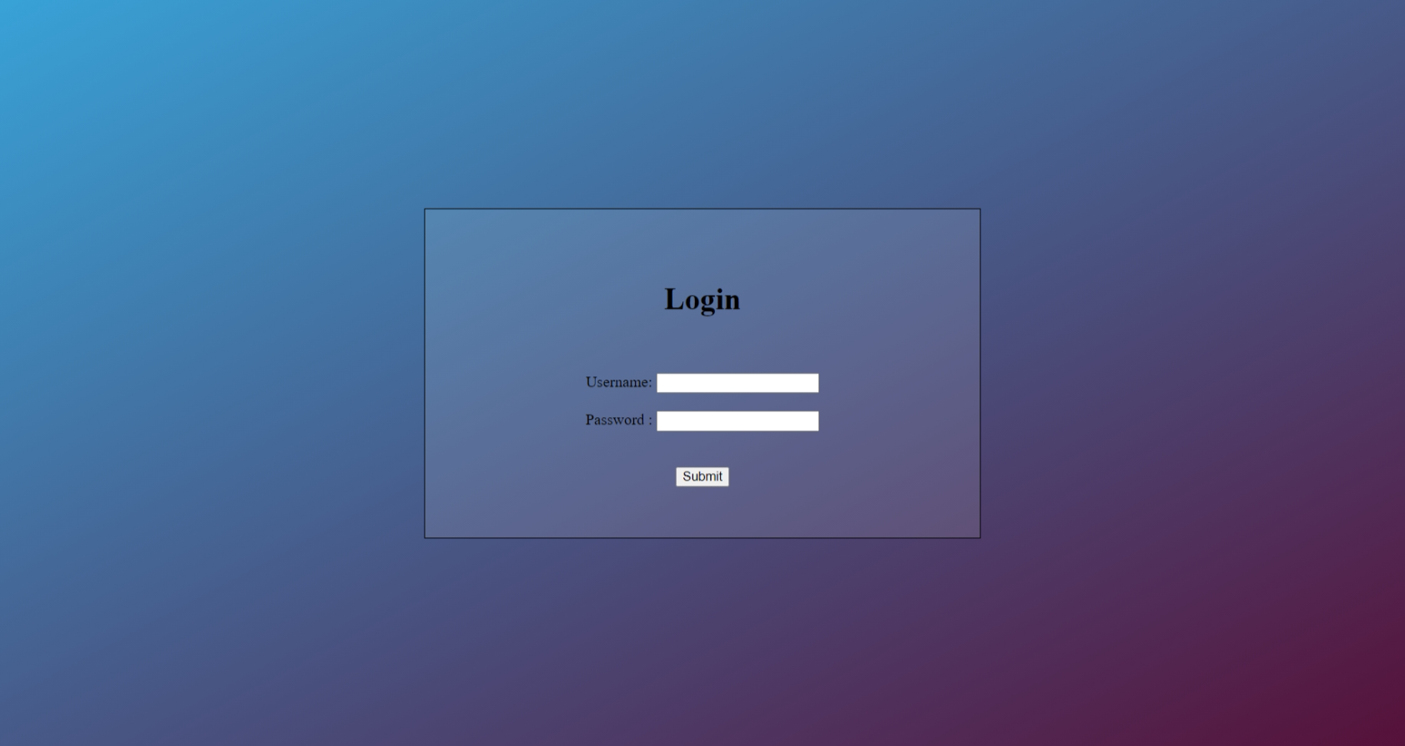

Slide 6
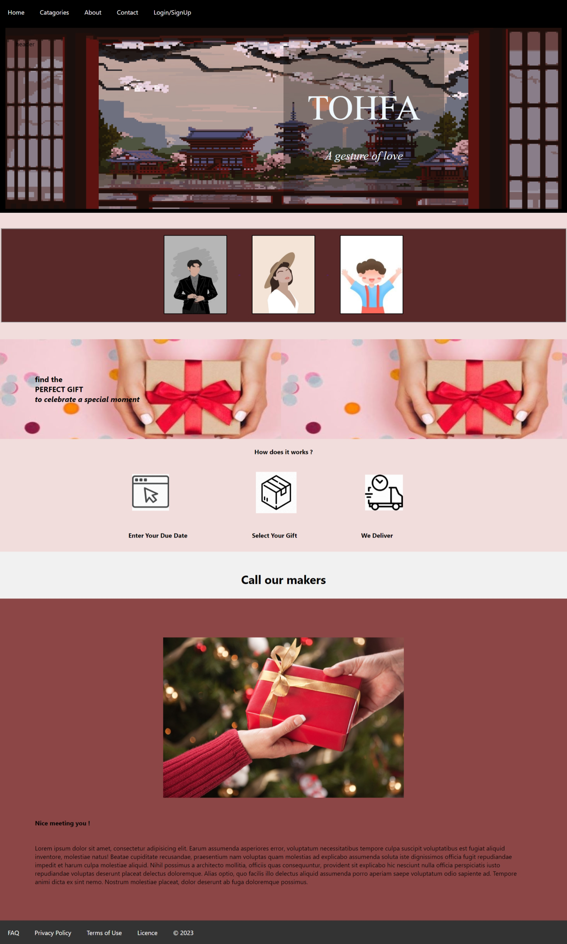

Slide 7
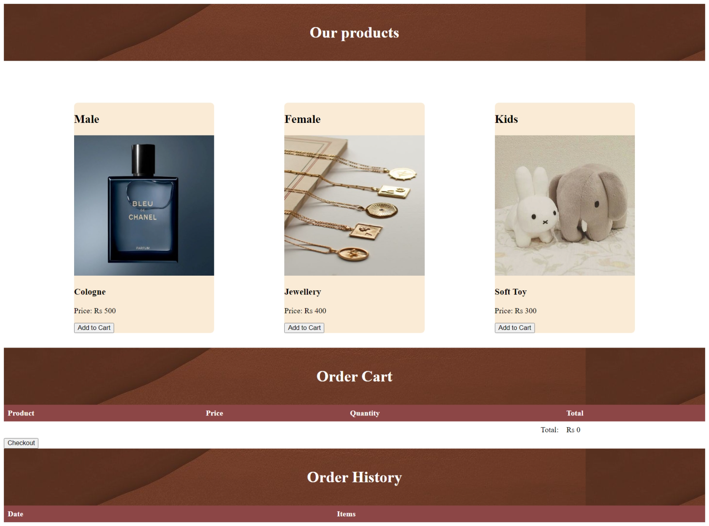

Slide 8
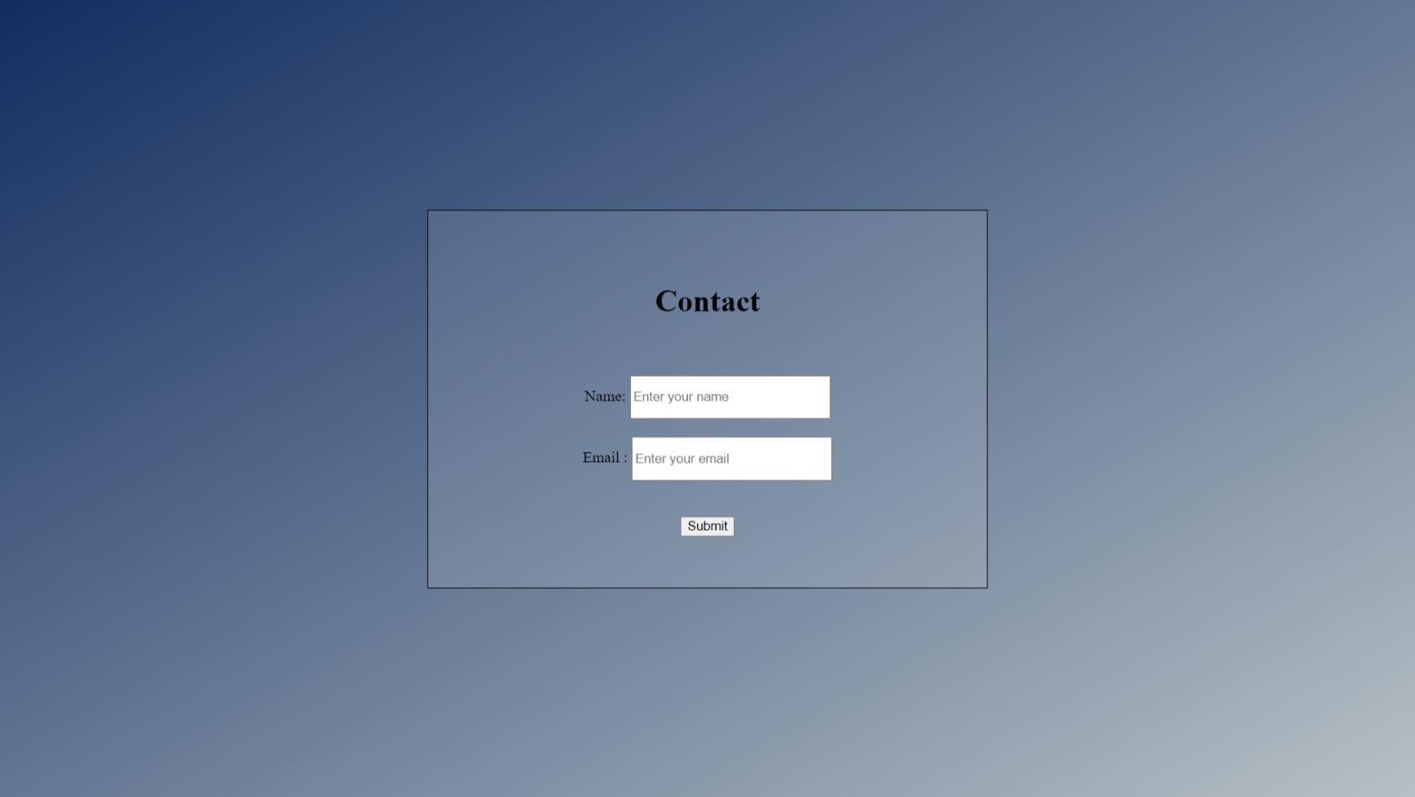

Slide 9
The chief features of this website are:
1. The website has a login page that connects the user to the website when valid data is entered into it.
2. The website has various filters and is categorized based on these filters to provide an easier and more conventional shopping experience.
3. Firstly , the website is categorized into 2 different categories, based on the gender, these appear on the main page of the website:
- Male
- Female
4. Then it is categorized according to the age so a kids category is also included in the options.
5. The website also has a contact us page that helps us to connect with the user and solve their queries.
6. If a user likes an item, an ‘add to cart’ option is provided below each item, the user can press the button and the product would be added to cart.
7. Once purchased the product would aslo be shown in ‘Order history’ of the website.

Slide 10
conclusion
As a gift shop website, it is important to have an appealing and user-friendly website design that showcases your products in an organized and easily accessible manner. The website should also have clear and detailed product descriptions, high-quality product images, and an easy checkout process to ensure a positive customer experience.
In conclusion, running a successful gift shop website requires a combination of a visually appealing and user-friendly website design. Offering personalized and customized gift options can also set your gift shop apart from competitors and provide customers with a unique and memorable shopping experience.

